Slide 1
Cubesat solar panels
May15-12
Client: John Carr, NASA
Advisor: Gary Tuttle

Slide 2
Preliminary Problem Statement
Our group is tasked with designing and implementing a deployable and retractable boom that fits inside a 1 cubic foot satellite used to deploy and retract a solar cell array with a minimum area of 9ft².

Slide 3
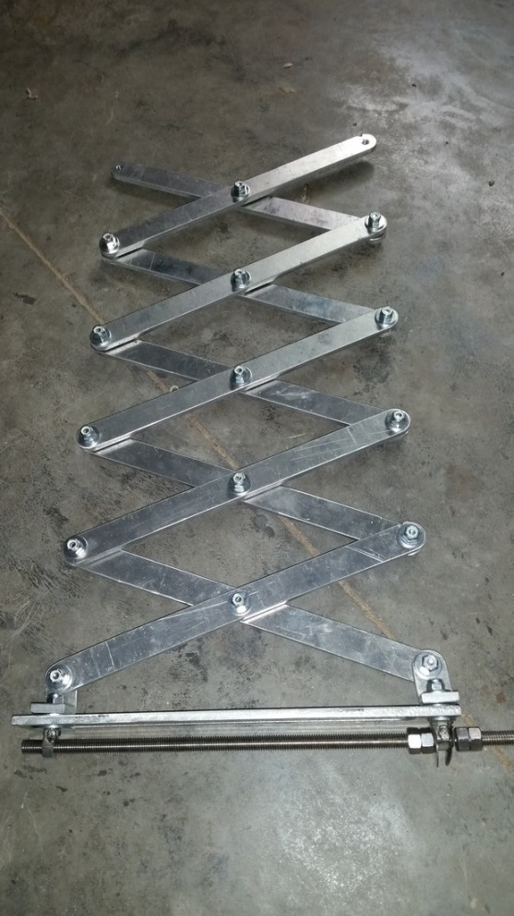
Preliminary Designs-Scissor Jack
Size Constraint
  1ft³ cube
  9ft² solar panels
Scissor Design
  Motor
    3 ft-lb
    2 phase motor deploy and retract
    Stepper motor
  Power Transmission
    Screw drive
Notes:
How was 3 ft-lbs

Slide 4
Problem Statement
Our group is tasked with designing and implementing a repeatedly deployable and retractable solar cell system that is to be launched into Low Earth Orbit. The system must fit within a 1U CubeSat (10cm x 10cm x 10cm satellite). Flexible solar arrays shall be used that have a minimum bend radius of 2.5cm and must cover at least 3720cm².

Slide 5
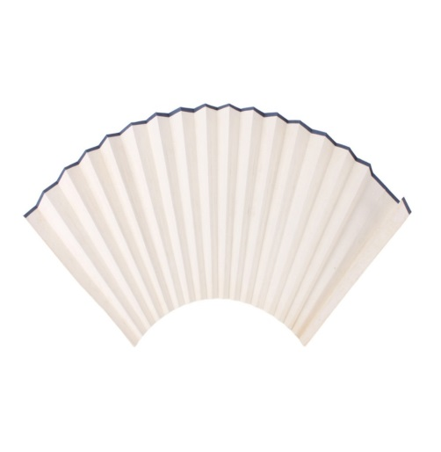

Preliminary Designs-Fan
One dual phase motor
Multiple servo motors
Difficult to reach 4 ft² solar panels
Gear Drive
  At pivot point - 360° rotation
  One to unfold – achieve more than 1 foot radius
The Area of this method will never achieve 100% full of solar cells
  25mm bending radius
  A_{cell,min} = 1cm x 1cm
Solar Panel Calculation.
$$A=πR^{2}$$
$$R=\frac{4ft^{2}}{π}$$
Notes:
Servo – Position control, require a control signal.
DC motor – using pulse width modulation (PWM)

Slide 6
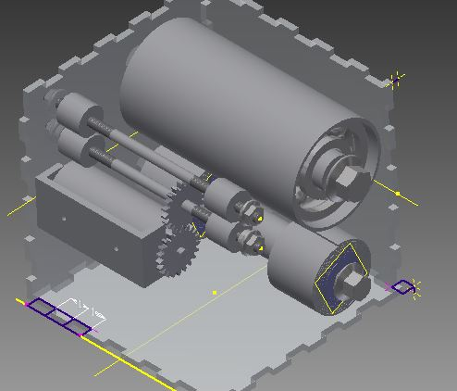
Preliminary Design-Tape Measure
Measure tape technique
  Motor
    100+ oz-inch
    Brushed motor
    Single phase motor deploy
    Continuous
  Power Transmission
    Spur Gears deploy
    Retract – spiral coil
Size Constraint
  1000cm³ cube-sat
  4-9ft² solar panels
Notes:
Brushed vs Brushless:
Brushed – low cost, small enough to use in the cubesat
If the cube-sat is bigger – suggest to use brushless, due to low maintenance, avoid corrosion overtime.

Slide 7
Final Design Decision
Design |  | # Mechanical Components | Size | Solar Area | Motor Torque Require | Prototype cost | Final Grade
1 | Fan | Low | 1 | Limited | High | Medium | 11
2 | Scissor | Medium | 1 | Neutral | High | Low | 13
3 | Tape | High | 2 | Neutral | Low | Medium | 14
 | Color Code Grading
 | 1
 | 3
 | 5
Size Chart
1 | Restricted Size
2 | Linient

Slide 8
Functional Requirements
Repeatable operation
Low power consumption
Structural rigidity when extended
Physical Limitations of Materials
Receive and interpret the signal
Monitoring boom extension for excessive torque
Latch at full extension

Slide 9
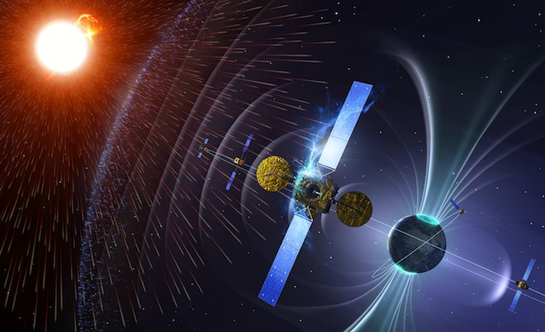
Non-Functional Requirements
Temperature
Radiation
Elasticity
Reliability/Lifetime
Fixed components
Weight
Size
Accessibility
Notes:
Temperatures in Low Earth Orbit can range from -250°F(-157°C) to 250°F(121°C)
Radiation can range from 100-10,000 rad(Si)/year depending on inclination in orbit
The spring should apply enough tension to keep solar array taut without compromising solar array integrity
Ensured by following non-/functional requirements
We need fixed components for vibrational considerations as well as vacuum conditions so that our parts remain in their initial positions.
Weight of each component needs to be considered due to transportation.

Slide 10
Market for CubeSats
Comparable Cost: $10,000
Purpose: Space Research
Users
  NASA
  Universities
  Private Corporations
Notes:
Provide specific examples of what has been learned from cube sats

Slide 11
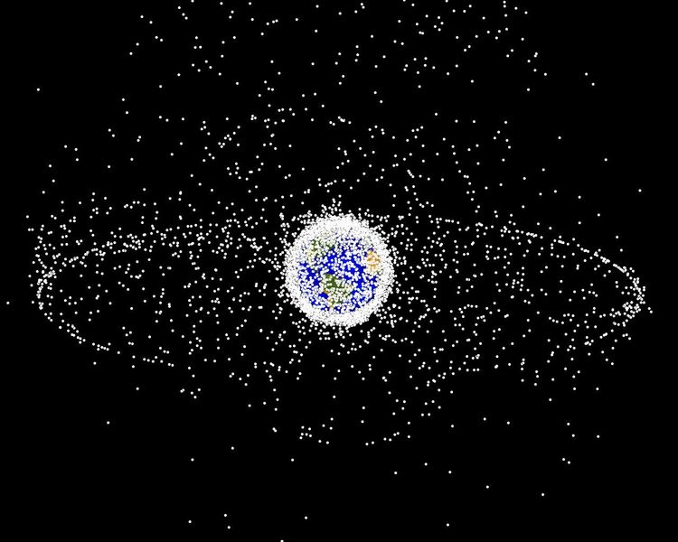
Potential Risks in LEO
  Temperature swings (-250F to +250F)
  Radiation exposure
  UV exposure
  Extremely low pressure (Vacuum)
  Near zero ease of access

Slide 12
Material Costs
Total Prototype Cost: $136.01
Total Final Cost: $2,398.50
Notes:
Explain these are costs for our non-space rated mock-up
Make this table “fit” the page better

Slide 13
Technology Platform
Hardware
Atmel Rad-Hard FPGA
Motor
Motor controller
Relays
Solar array
Software
VHDL
A2D conversion
5.5 V Regulator
3.3V Regulator
Power Jack
Relay
Altera Cyclone V Programmable Logic Controller
Motor Controller
Forward/Reverse Bias Motor
Locking Solenoid
Stop Sensors
Human Interface

Slide 14
Implementing Prototype
Each individual member researched & selected at least one component of the final design
For each component members were asked to create a test for functionality
Individual Components to be Tested
FPGA Solenoids Motor Bearings | Motor controller Wheels Springs Tape
Notes:
Implementing the prototype this semester means that we conduct the tests we wrote up for each component
Examples
Digital logic for PLC has been tested on the Altera Cyclone II FPGA
Solenoid has been bench-tested and found that 3 V is required to make connection
Motor will be bench-tested by measuring voltage constants, terminal resistance, & torque
Silicone rubber wheels will be tested for static & kinetic friction tested dry against a sled with a calibrated load

Slide 15
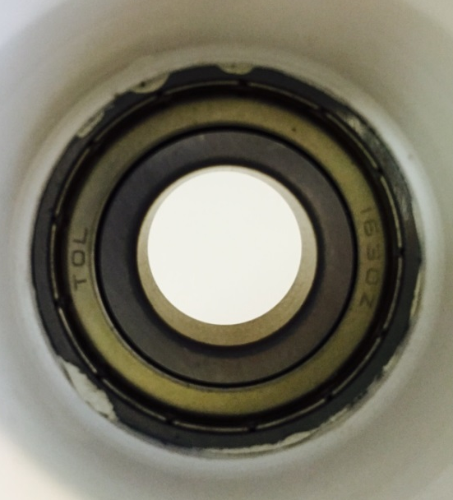
BEARINGS
Prototype
  Fastenal
  30-35% Greased
Space Implementation
  Timken
Design, Structure and Testing
Lubrication
  Prototype
  NASA test and usage

Slide 16
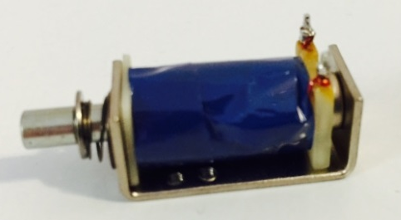
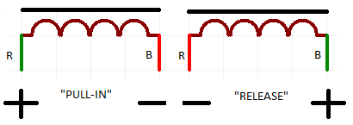
Solenoids
General
Used to latch boom
Reduce power consumption
Testing
Magnetic Latching System
Stays in position when voltage is removed
  Held out by spring
  Held in by magnet
Reverse voltage to move core in other direction
“Zero-Power-to-Hold”

Slide 17
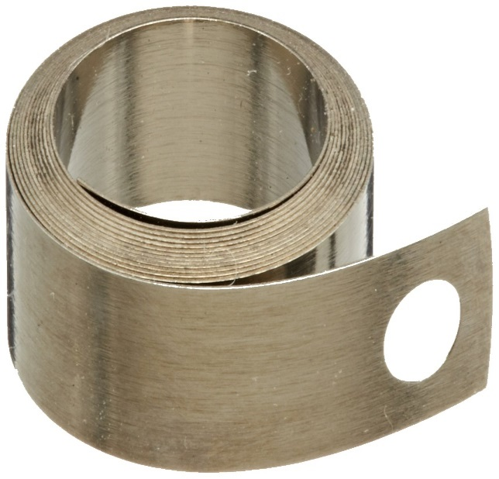
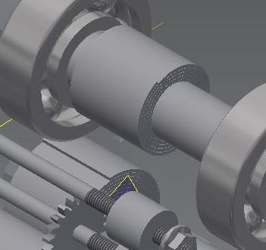
Constant Force Spring
Prototype spring:
  Compact
  Correctly tensioned
  Low cost
For NASA’s actual use
  Vulcan Spring’s products recommended

Slide 18
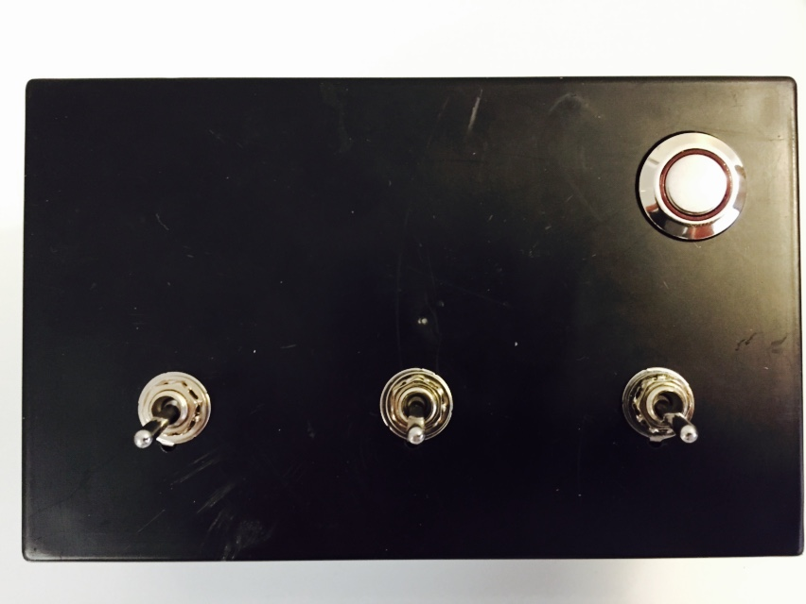
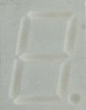
Human to Machine Interface
Test Requirement
Momentary Push Button
Three Switches
  Stop
  Send Out
  Send In
Seven Segment Display
Notes:
What voltave does this run at.

Slide 19
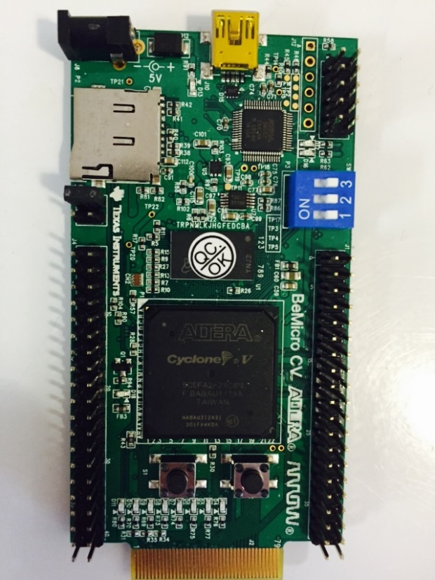
Field programmable logic controller
ALTERA Cyclone V Test
AT40KEL040
  Rad Hard
  233 I/O Pins
  ATMEL FPGA Designer®
3.3V Supply
Reprogrammable
  Quartus II VHDL
MIL STD 883 Method 1019.9

Slide 20
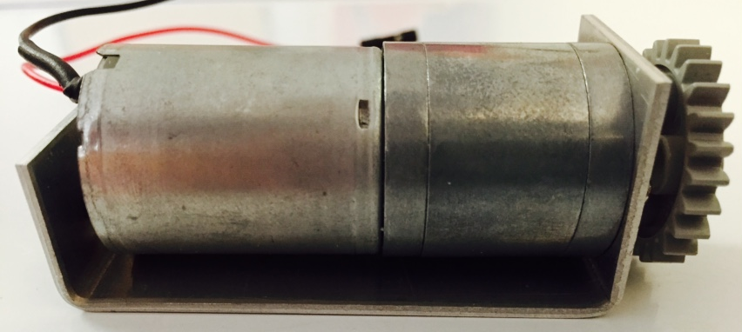
Motor
Brushed DC motor with gearbox
57 rpm
Small size
260 oz·in stall torque
Terminal resistance and torque testing

Slide 21
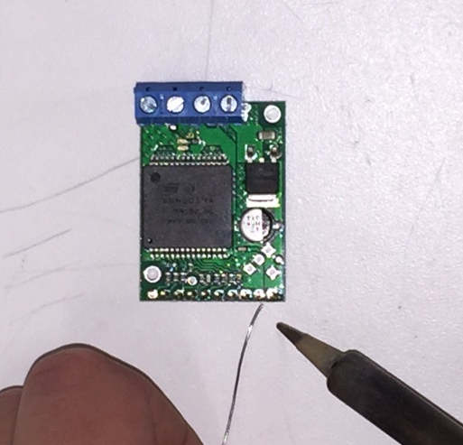
Motor Driver
Operates at 5.5V delivering continuous 12 A
Various built in shutdowns and protections
Compact Size
Test current sense ability and LEDs

Slide 22
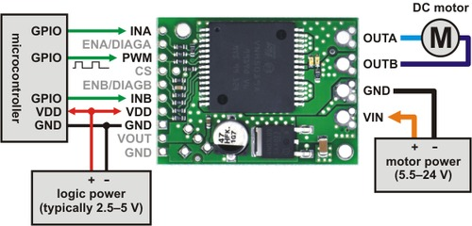
Electrical Interface
172:1 Gearmotor with 260 oz-in stall torque
Motor Driver
Atmel Microcontroller
Notes:
Is this rad hard. How will we ensure this will work

Slide 23
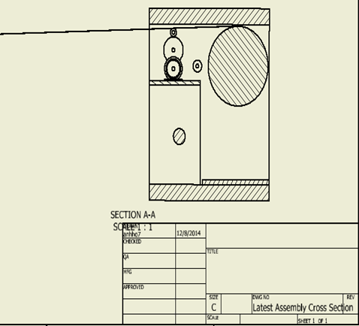
Zoom-in side View
Solar Panels
Connection of the Panels & tape
Free Roller
Solar Panel Roller
Measuring Tape
Gear Driven Roller

Slide 24
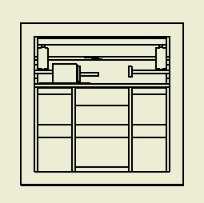
Zoom-in front view
Solar Panel
Free Rotating Roller
Tape
Gear Drive Roller

Slide 25
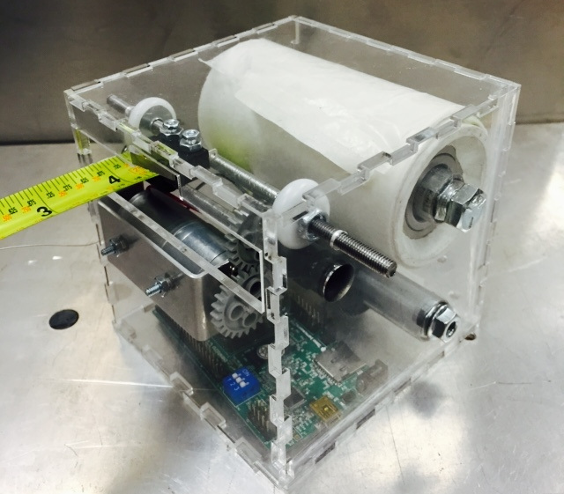
Final Design

Slide 26
MILESTONES
Analog or Digital 10/05/2014
Circuit Outlines and Improvements 10/31/2014
Our Design Constraints were changed 11/01/2014
Redesigned our 1U CubeSat 11/12/2014
Final Circuit Completion 11/26/2014
Material Selections 12/05/2014
Draft Design Sent to NASA 12/06/2014
Bill Of Materials 12/07/2014

Slide 27
SEMESTER SCHEDULE
Material Ordering 01/30/2015
Begin building 02/20/2015
Circuit Assembled 04/08/2015
Complete Local testing 04/17/2015
Submit Final Documentation to NASA 05/04/2015

